Slide 1
Data Analysis for US AIR Pollution
Xiang Liu
Xue XU

Slide 2
Agenda
Project Overview
Inspirations
Data Pre-processing
Data Analysis
Conclusion
Reference

Slide 3
Project overview
This dataset includes four major pollutants (Nitrogen Dioxide, Sulphur Dioxide, Carbon Monoxide and Ozone) for every day from 2000 - 2016 and place them neatly in a CSV file
Pollutants | Cause
NO2 | are expelled from high temperature combustion, and are also produced during thunderstorms by electric discharge
SO2 | produced by volcanoes and in various industrial processes
O3 | brought about by human activities (largely the combustion of fossil fuel)
CO | vehicular exhaust contributes to the majority of carbon monoxide let into our atmosphere

Slide 4
ToxiTY
Pollutants | Toxity
NO2 | Breathing difficulties, Throat spasms, Headache, Fatigue, Nausea
SO2 | Temporary respiratory problems, chronic bronchitis, emphysema, decreased fertility, coughing
O3 | Irritant effect on the respiratory tract; stimulation of atherosclerosis
CO | Confusion, vision and balance problems, Loss of consciousness, Nausea and vomiting, Headaches

Slide 5
Dataset
There is a total of 28 fields. The four pollutants (NO2, O3, SO2 and CO) each has 5 specific columns. Observations totaled to over 1.4 million
Column Name | Description
NO2 Units | The units measured for NO2
NO2 Mean | The arithmetic mean of concentration of NO2 within a given day
NO2 AQI | The calculated air quality index of NO2 within a given day
NO2 1st Max Value | The maximum value obtained for NO2 concentration in a given day
NO2 1st Max Hour | The hour when the maximum NO2 concentration was recorded in a given day

Slide 6
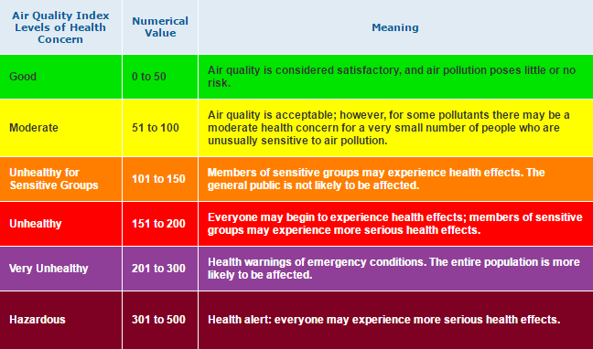
AQI --- Air Quality Index

Slide 7
Dataset
Column Name | Description
State Code | The code allocated by US EPA to each state
County Code | The code of counties in a specific state allocated by US EPA
Site Num | The site number in a specific county allocated by US EPA
Address | Address of the monitoring site
State | New Jersey…
County | County of monitoring site
City | City of the monitoring site
Date | LocalDate of monitoring

Slide 8
Inspirations
How is the concentration of each pollutant in US states?
Which time in a day has the maximum density of air pollutants?
From 2000-2016, the concentration of each pollutant increase or decrease?
Can we predict the trend of each pollutant in the future?

Slide 9
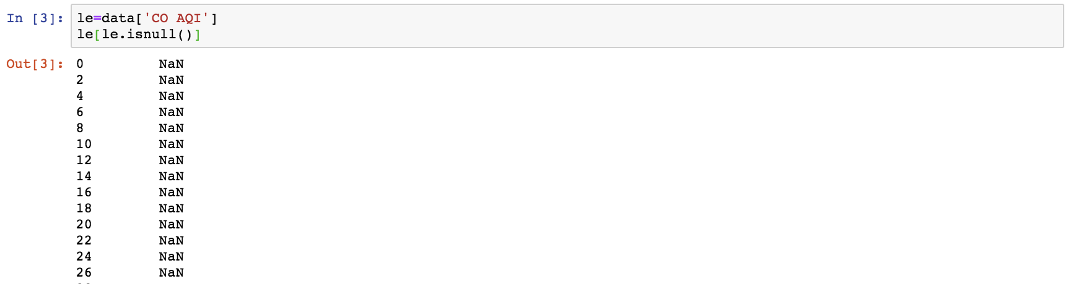
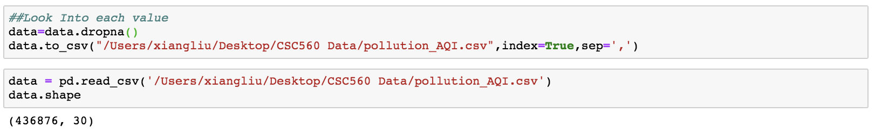
Data Preprocessing
Step 1 check if the data has missing value
Step 2 Use dropna to drop missing value

Slide 10
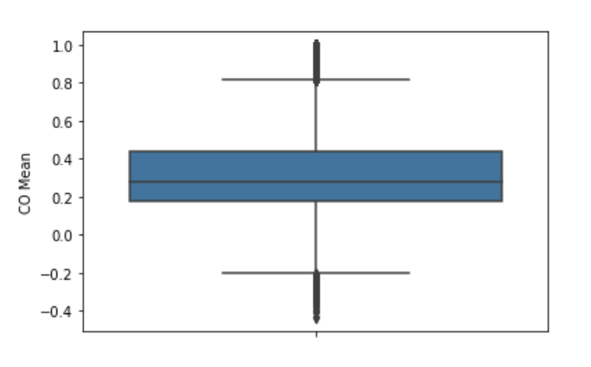
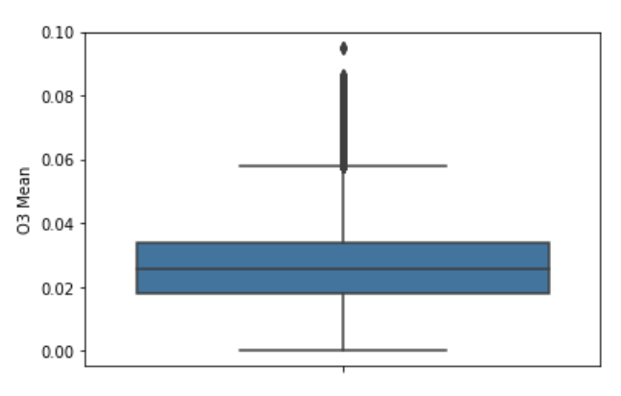
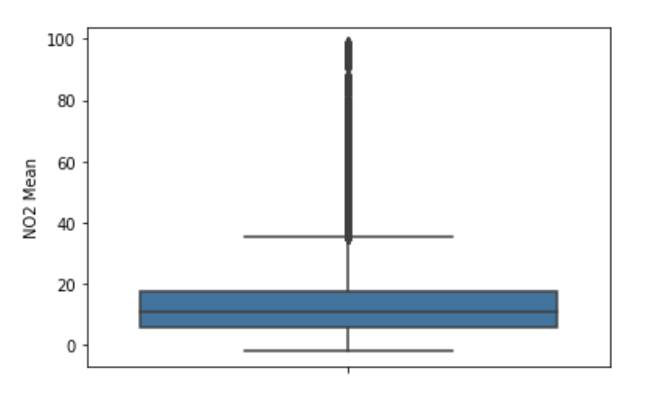
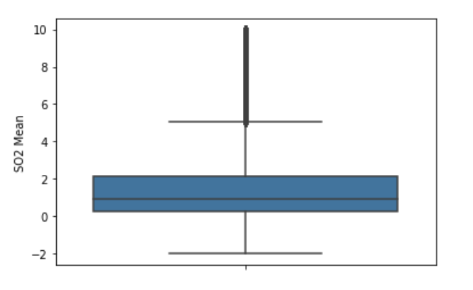
CO Mean
O3 Mean
Step 3 Check unusual value
NO2 Mean
SO2 Mean

Slide 11
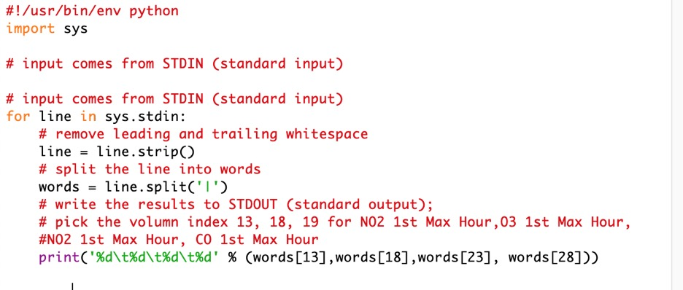
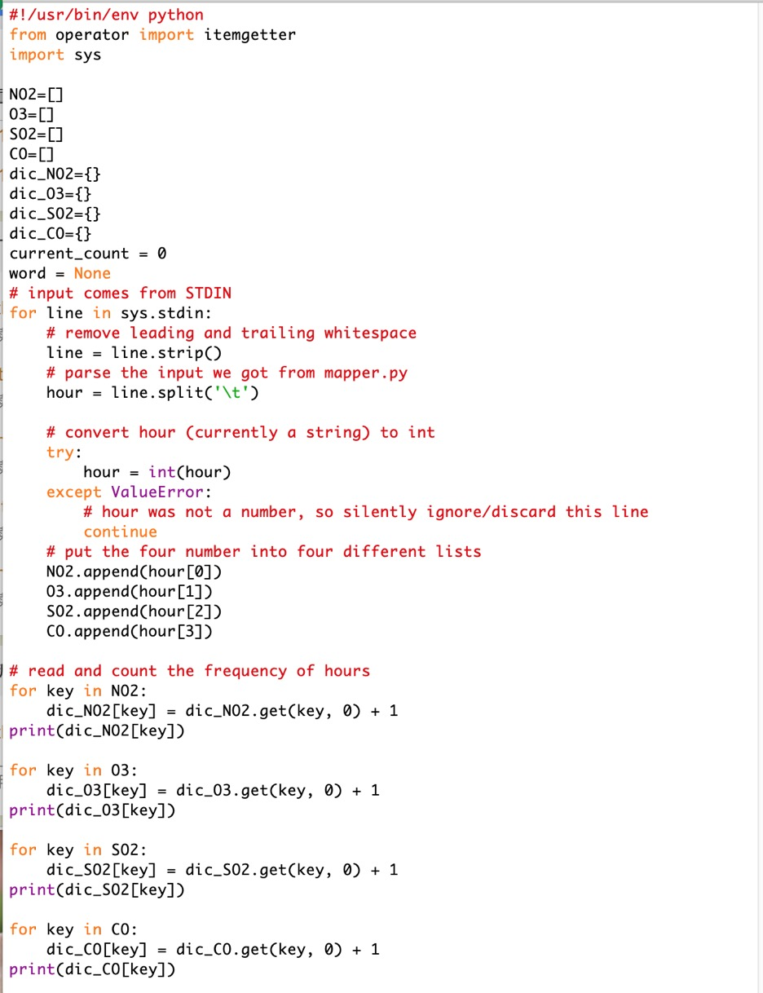
Hadoop m/r + Hive
hadoop jar /usr/lib/hadoop-0.20-mapreduce/contrib/streaming/hadoop-streaming-2.6.0-mr1-cdh5.13.0.jar
-input /tmp/data/pollu1.csv
-output /tmp/data/out_put01
-mapper /home/cloudera/myPractice/mapper.py
-reducer /home/cloudera/myPractice/reducer.py
Notes:
Output the data for each pollutant the count of Max_hour
Mapper ----- read the Max_hour for each pollutant and display in a list
Reducer---- count the frequency of each hour

Slide 12
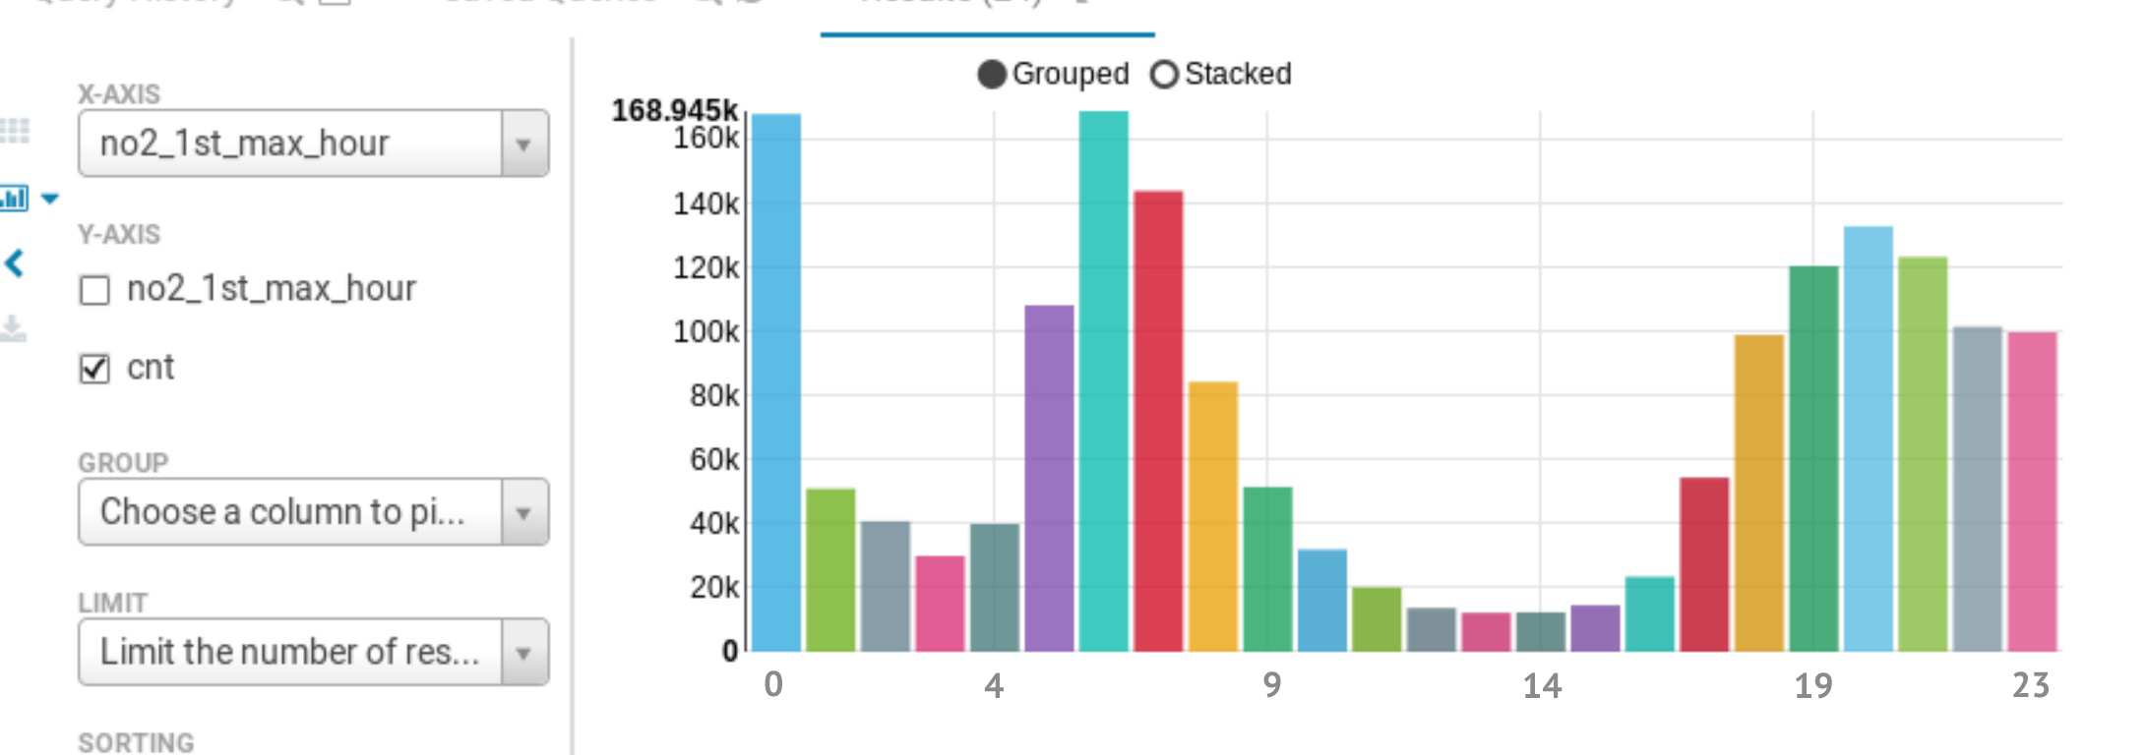
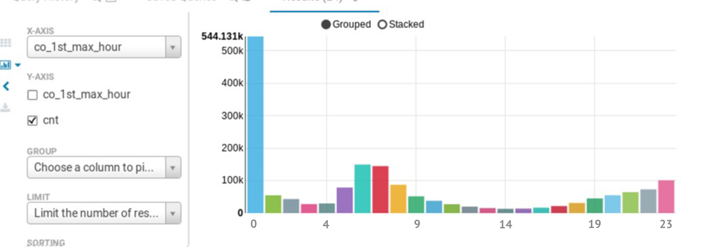
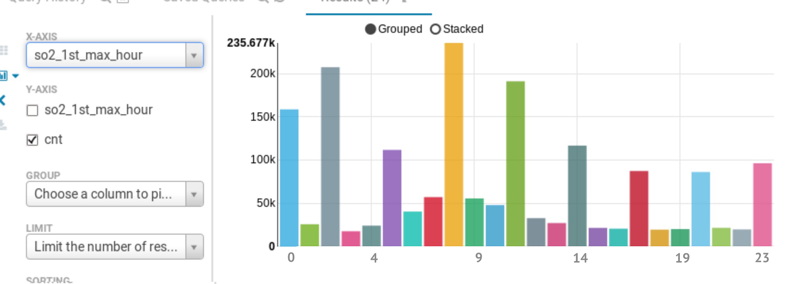
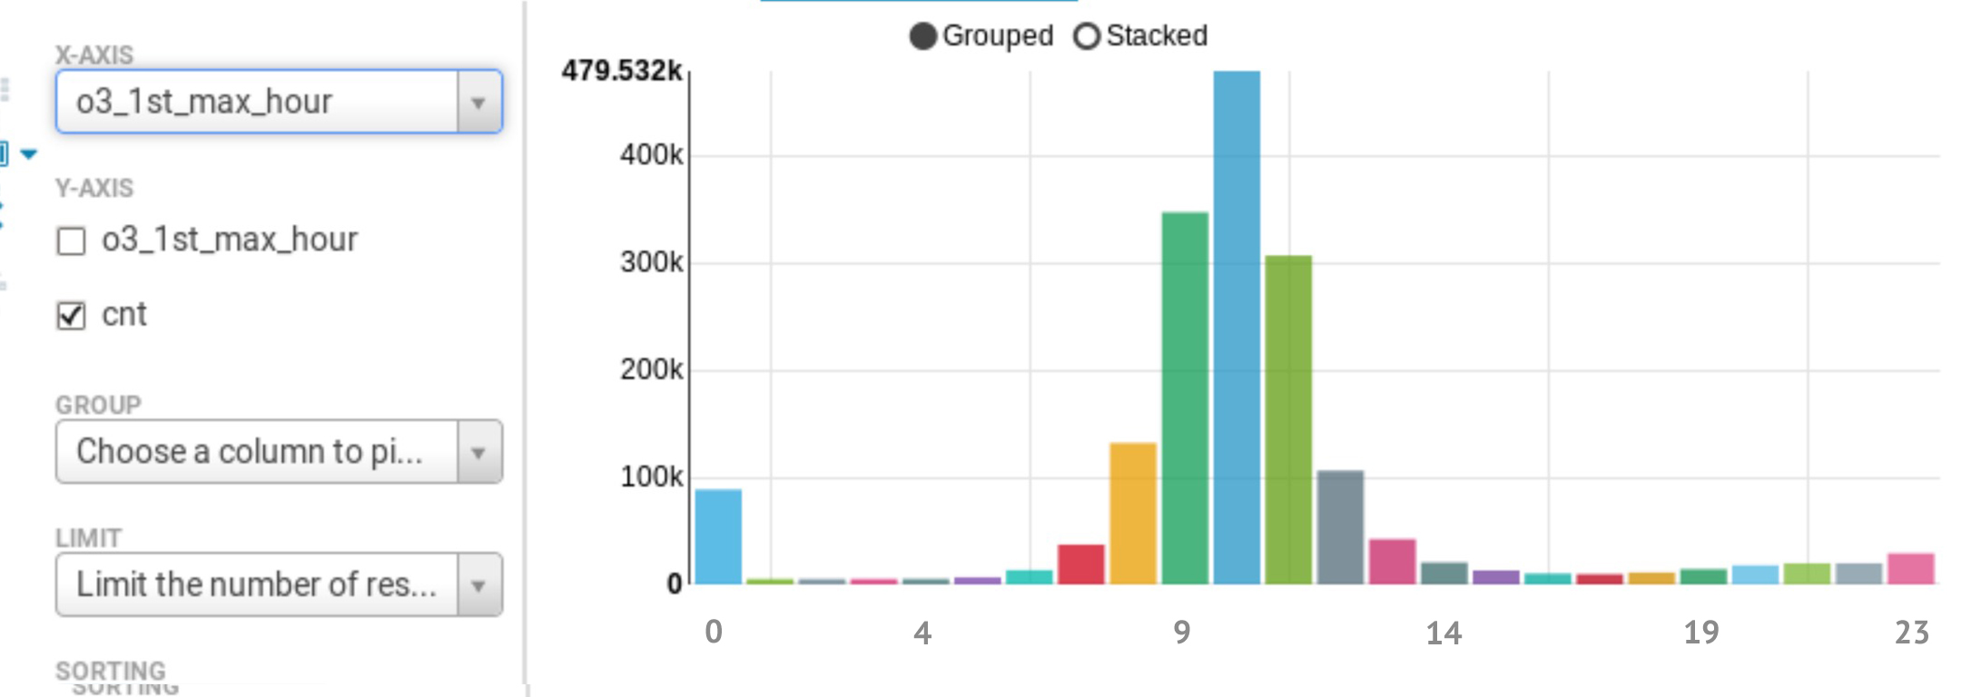
Data Analysis in Hive
NO2_1st_max_hour
CO_1st_max_hour
SO2_1st_max_hour
O3_1st_max_hour
Notes:
The whole US study
-For NO2, and CO have their max value between 5-9 am and 5-12 pm.
-For O3, the max value generally appears at 8 am- 1pm.
-For SO2, the pattern looks like this, the peak appears every three hours.

Slide 13
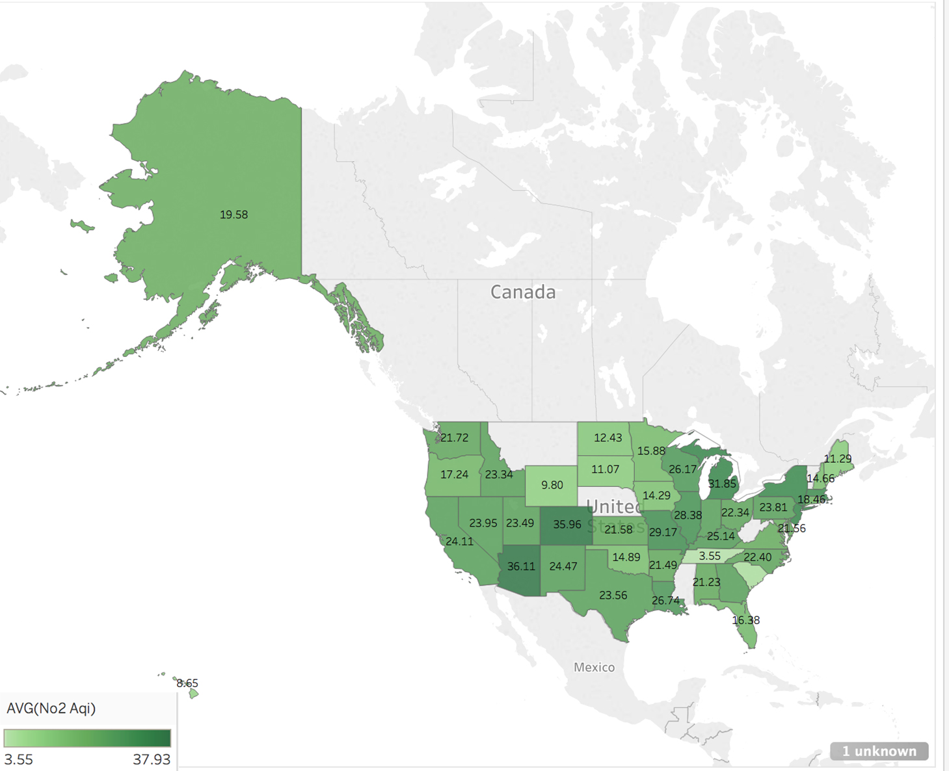
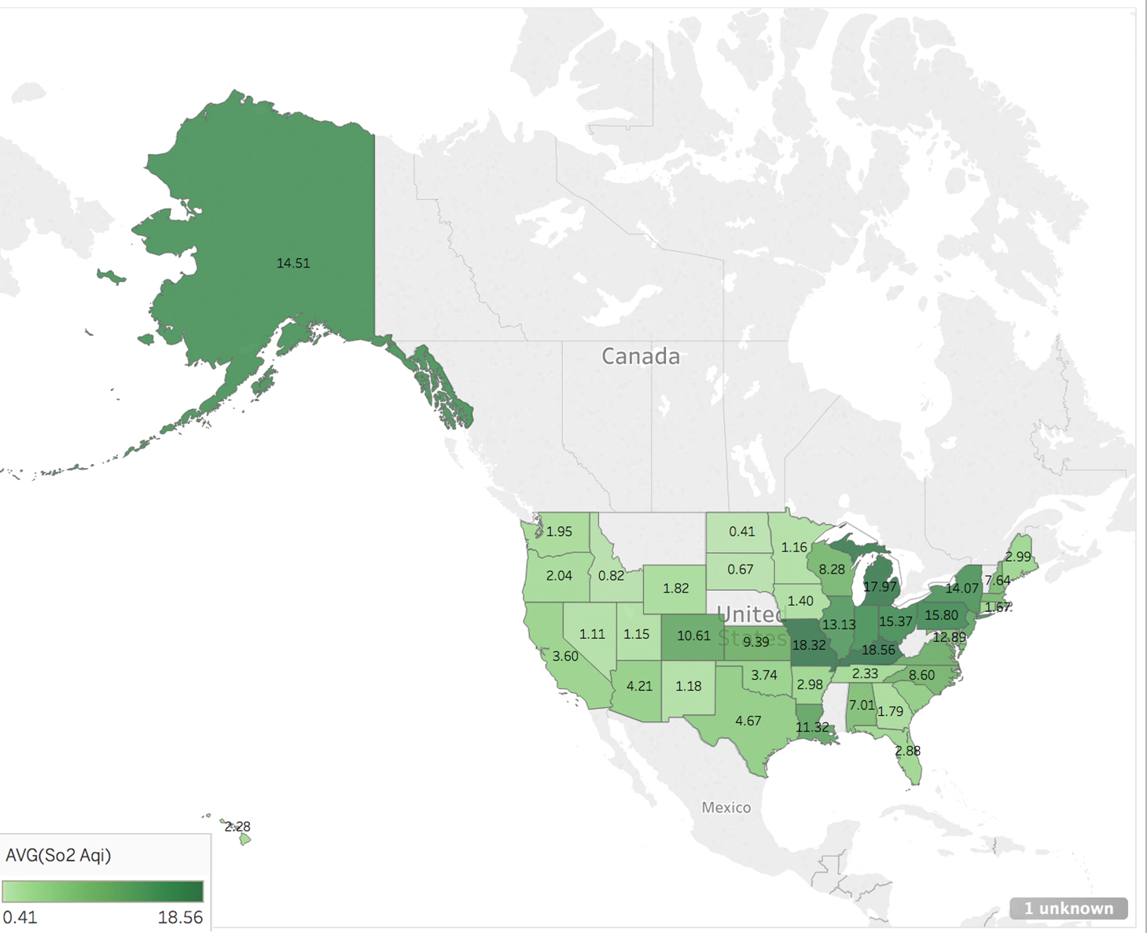
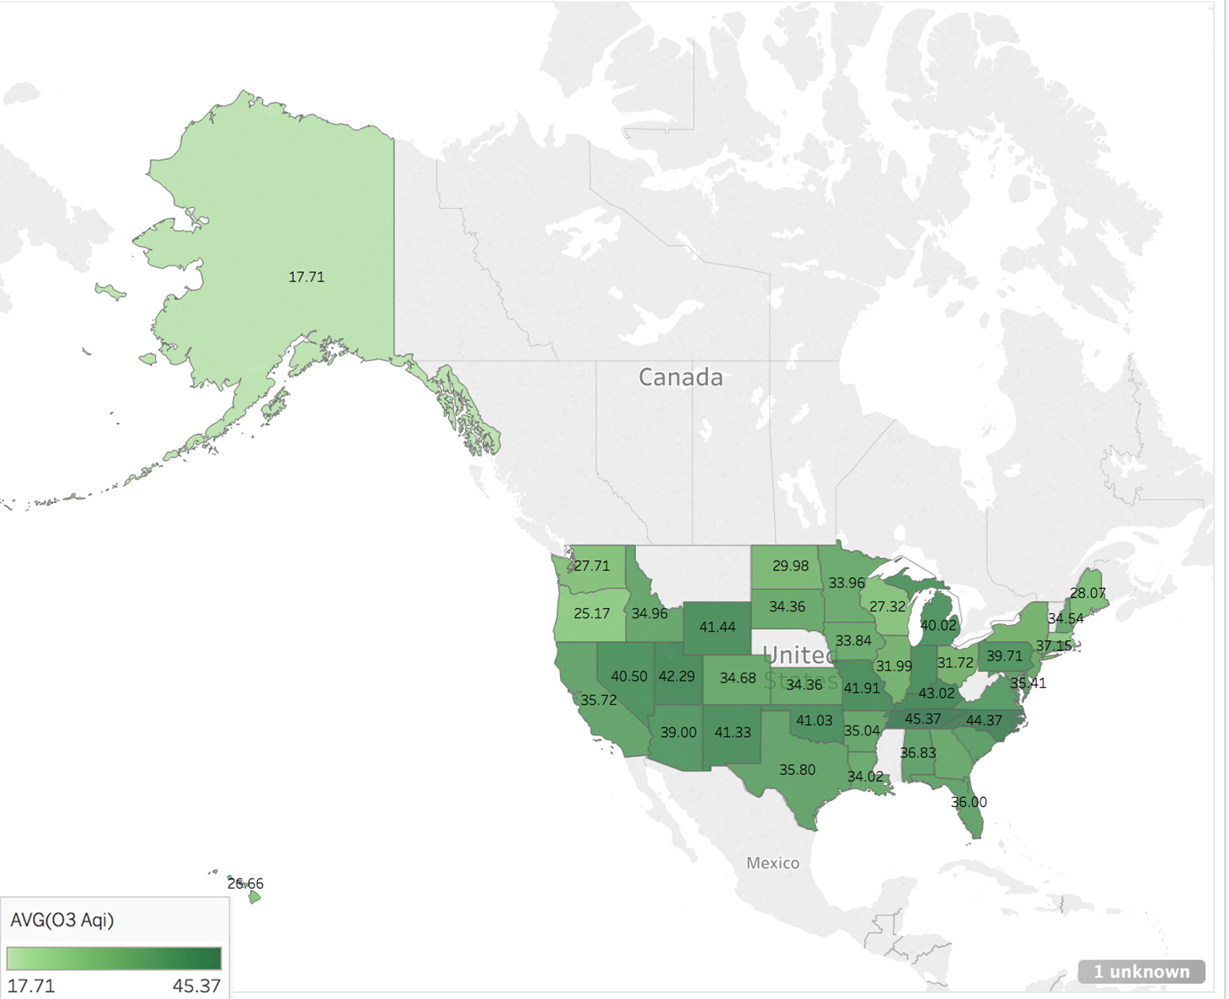
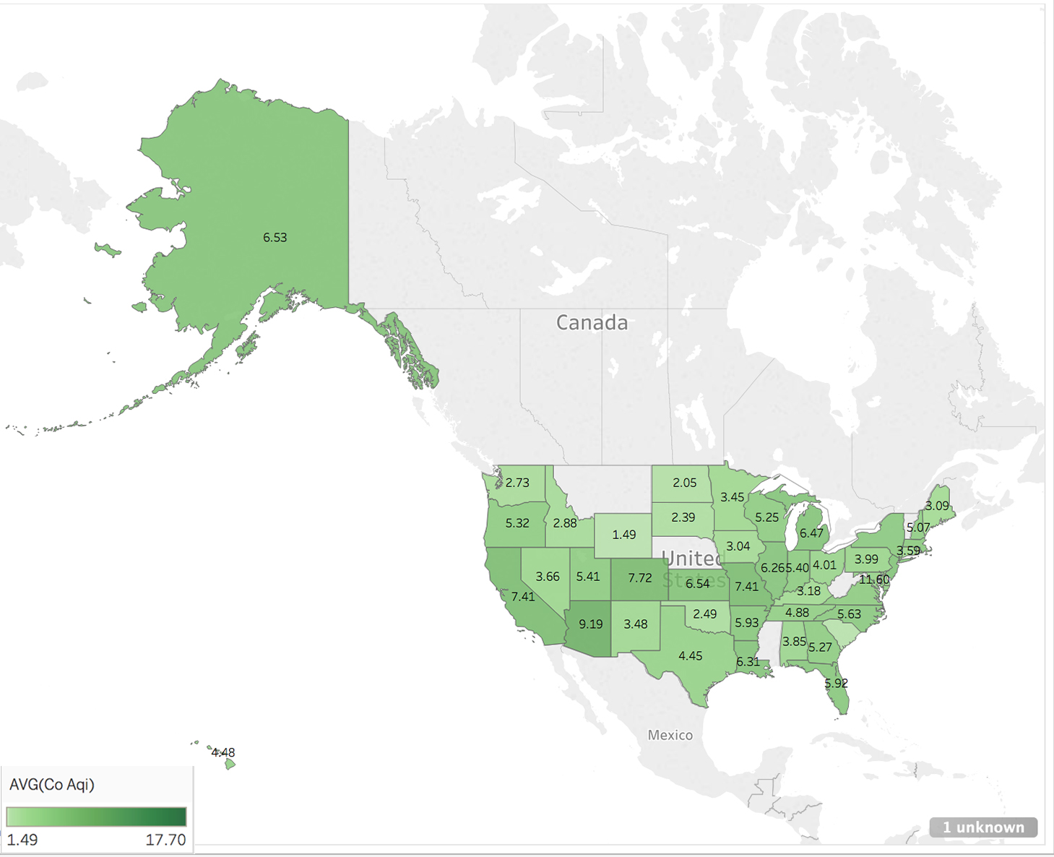
NO2 AQI
SO2 AQI
AQI AVG Value (State)
Except Montana, Nebraska, Mississippi, West Vigina, Vermont these 5 states
O3 AQI
CO AQI
Notes:
US AQI Average Value Group by state
-Overall, the average AQI for each pollutant is under the safe line (<50)

Slide 14
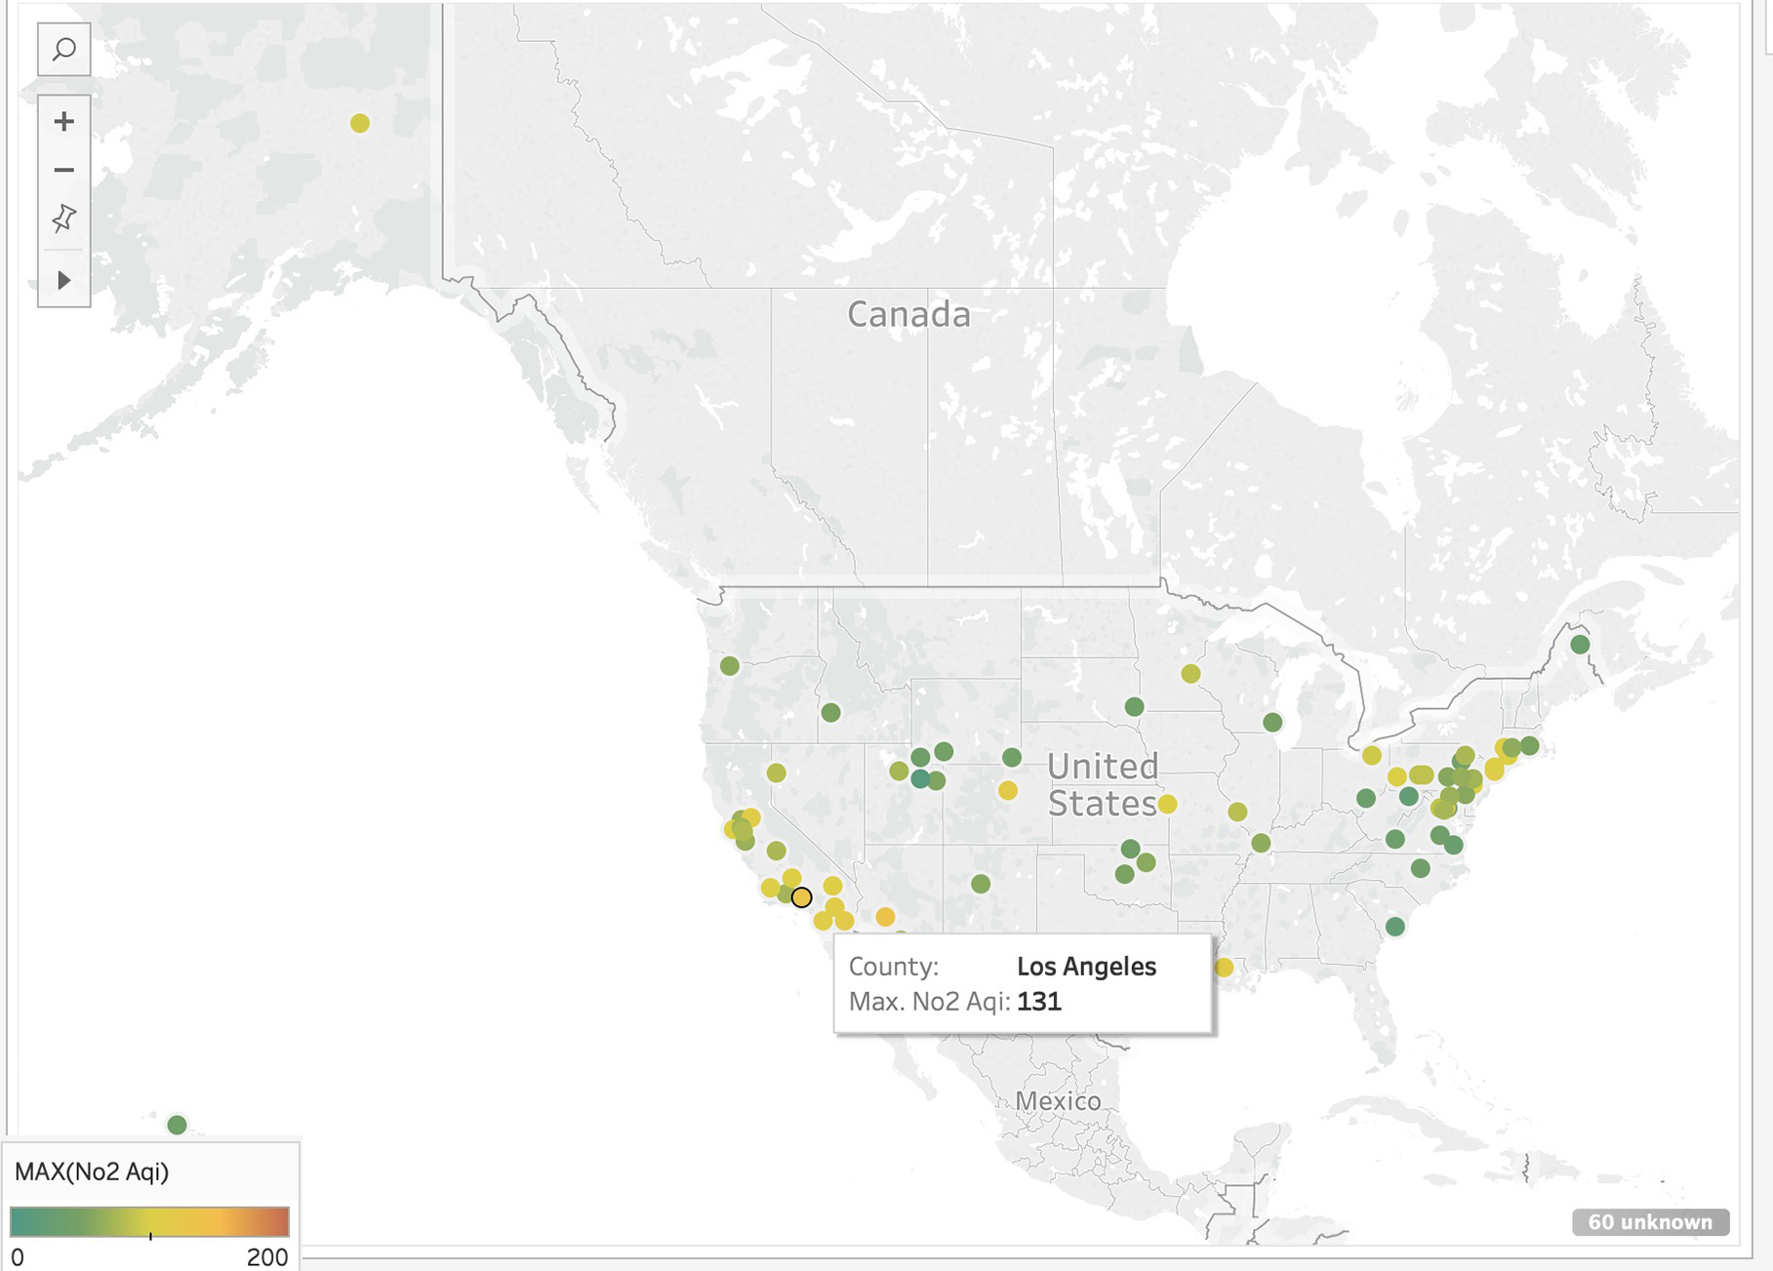
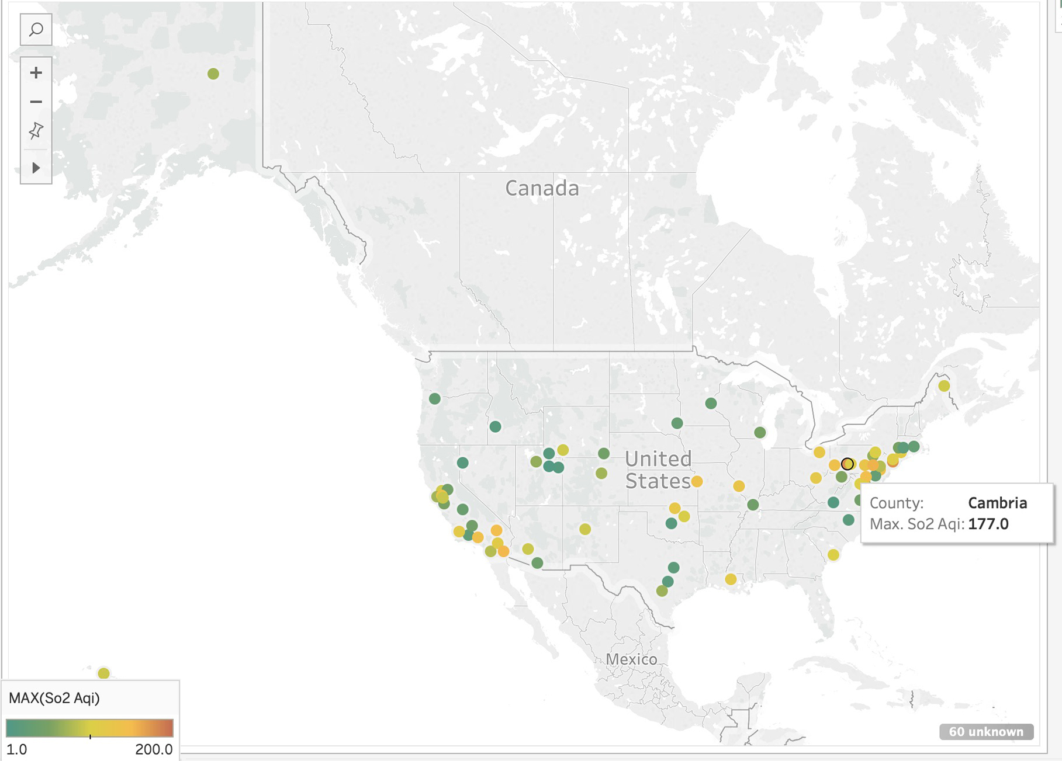
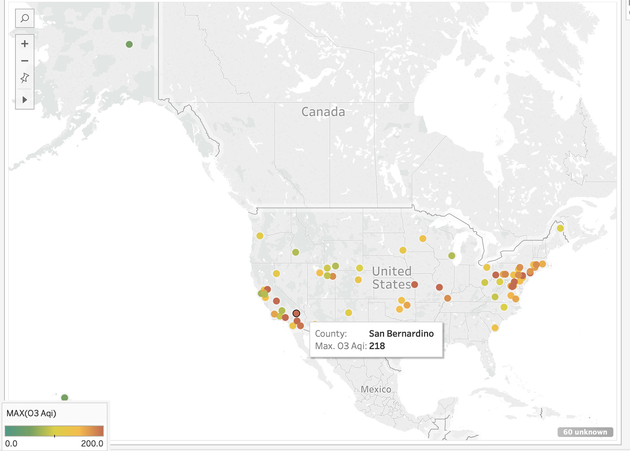
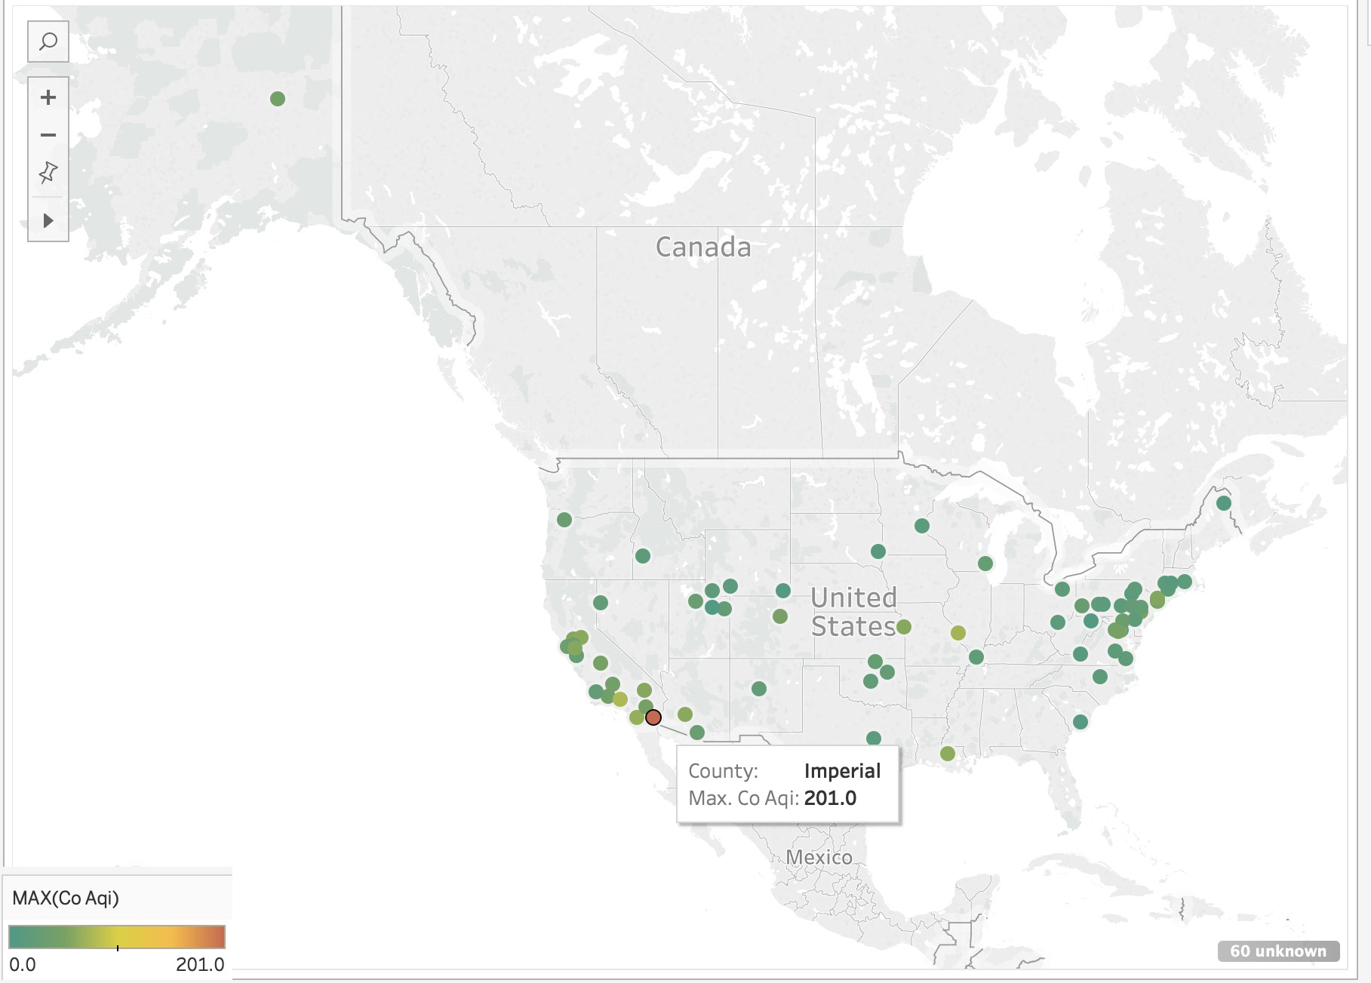
AQI Max Value (county)
NO2 AQI
SO2 AQI
O3 AQI
CO AQI
Notes:
Counties in East and West coast have slight pollution on NO2, SO2 ;
CO is under the safe level;
O3 values in some of the counties have exceed the safe level, might cause health issue.

Slide 15
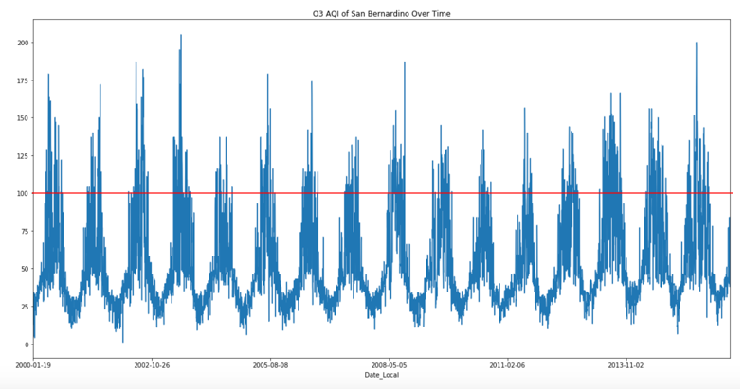
San Bernardino O3 AQI Analysis (2000-2016)
218
The frequency of AQI above 100
Notes:
AQI (or value) of O3 presents periodical changes

Slide 16
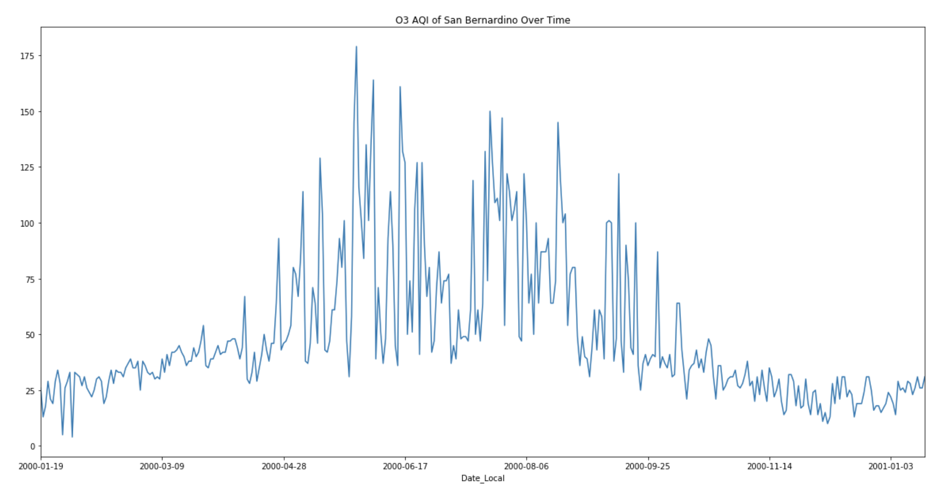
San Bernardino O3 AQI Analysis (2000)
The frequency of AQI above 100
Notes:
Peak appears between May - Oct

Slide 17
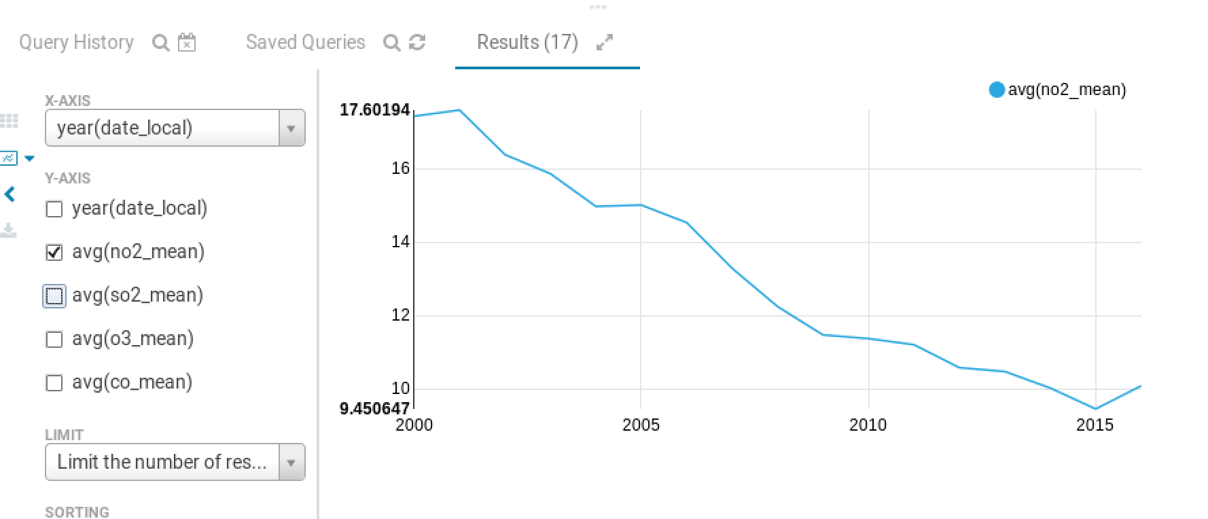
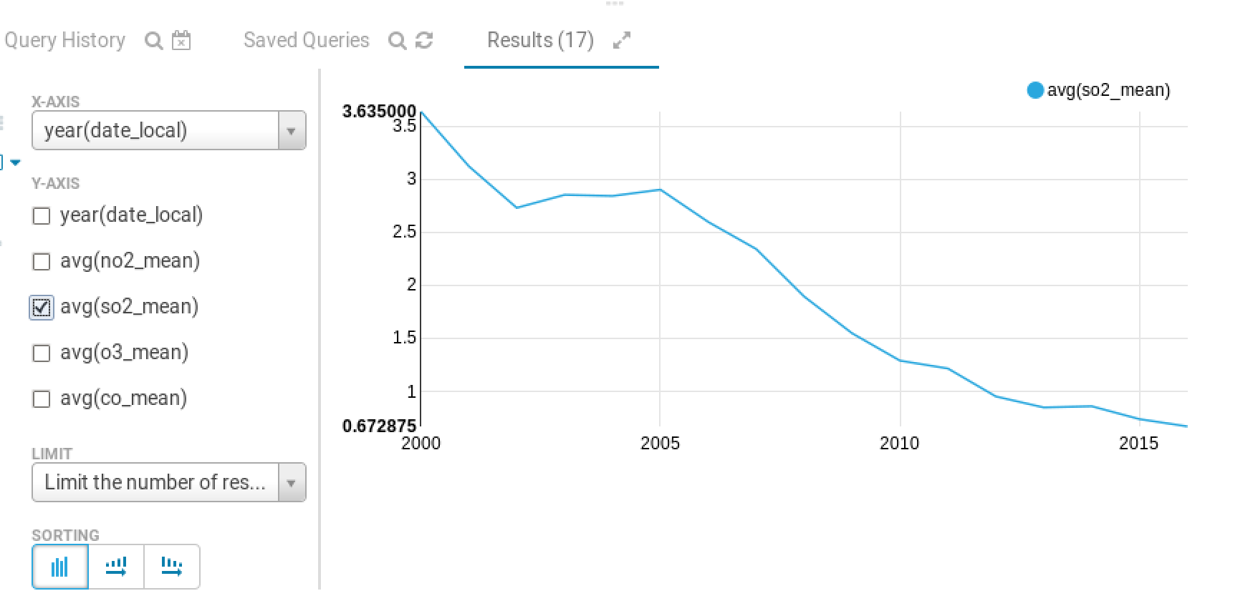
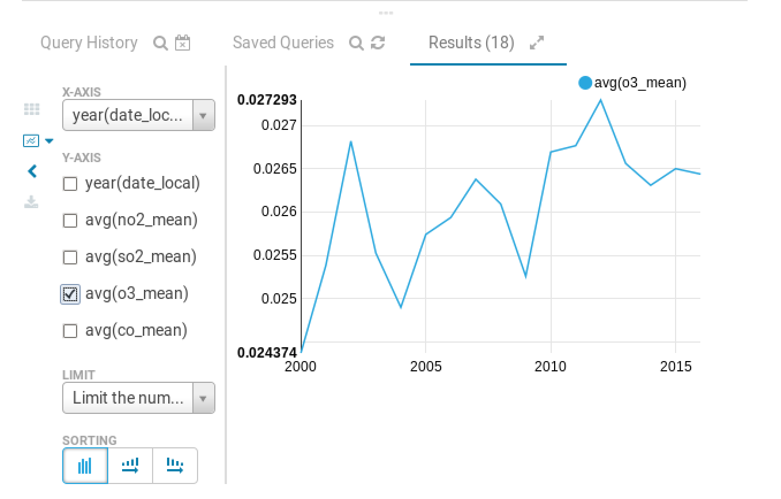
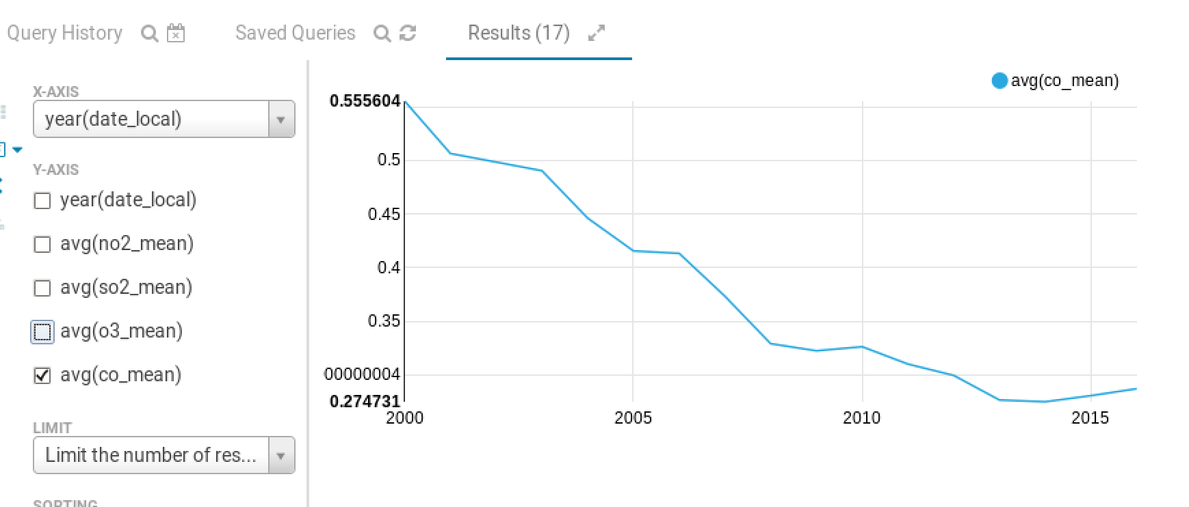
Data Analysis in Hive
NO2_mean
SO2_mean
O3_mean
CO_mean
Notes:
2. Mean Value by year study
-NO2, SO2 and CO are declining every year gradually.
-O3 is in a stable level with fluctuations.

Slide 18
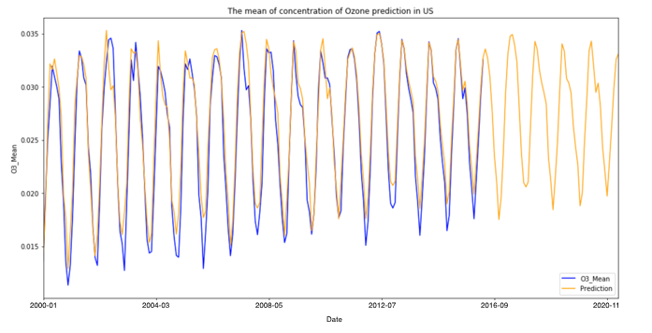
Linear Regression Model
Sklearn for the regression algorithm
Split our testing and training data sets, test_size equal to 20% of the data
Model accuracy is 0.95
US O3_Mean prediction

Slide 19
Summary
1.Max Value Hour’s study
-For NO2, and CO, most of the places have their max value between 5-9 am and 5- 12 pm
-For O3, the max value generally appears at 8 am- 1pm
-For SO2, the peak appears every three hours
2. Mean Value by year study
-NO2, SO2 and CO are declining every year gradually
-O3 is in a stable level with fluctuations
3. Pollution distribution
-Overall, the average AQI for each state is under the safe line (<50)
-Counties in East and West coast have slight pollution on NO2, SO2 ; CO is under the safe level; O3
values in some of the counties have exceed the safe level, might cause health issue
4. Study of O3 in a specific area (San Bernardino)
-O3 AQI presents periodical changes, peak appears between May - October

Slide 20
Reference
https://en.wikipedia.org/wiki/Air_pollution
https://enlight.nyc/projects/stock-market-prediction
https://www.kaggle.com/

Slide 21

Thank you for your attention

